Slide 1
Mary Lomas – Solicitor, Catastrophic Injury Department

Slide 2
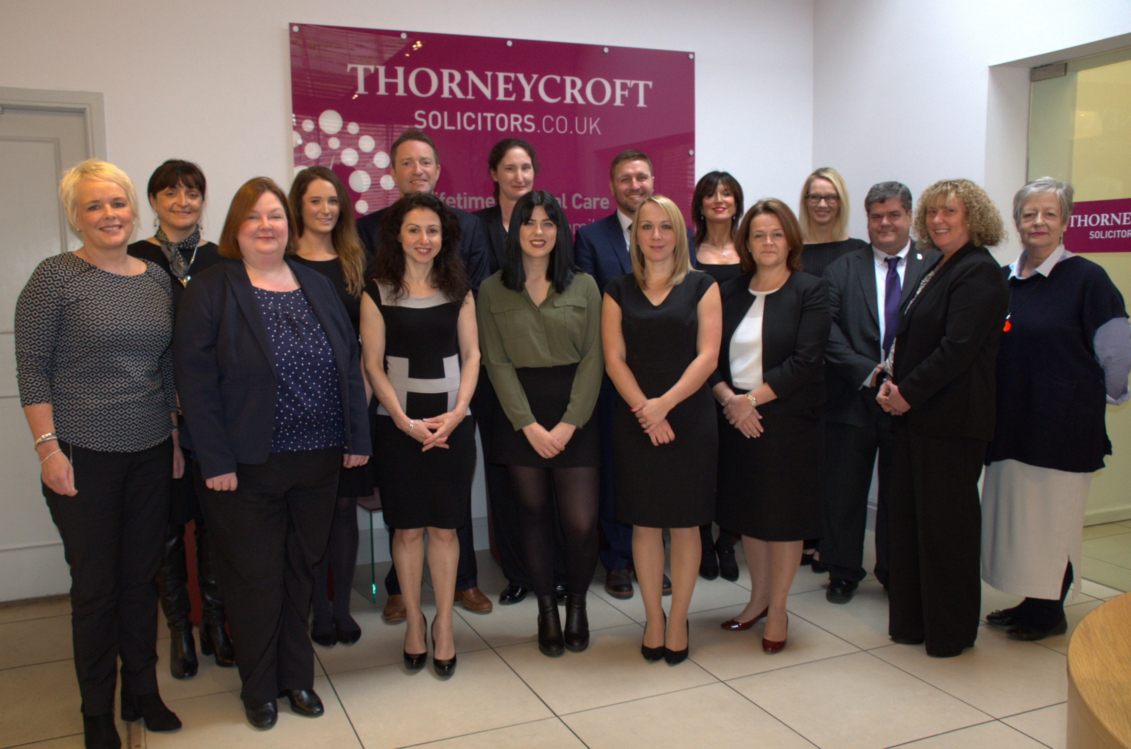
Who are we?
Solicitors based in Macclesfield with a strong national presence
Cover several areas of law including Catastrophic Injury
We are a talented legal team with a passion for helping catastrophically injured clients and their loved ones

Slide 3
Our team’s approach
Ensure the correct rehabilitation at an early stage
Instruct the best case managers and rehabilitation specialists in the country
Maximise the client’s recovery and quality of life
Compassionate
Tenacious
Always go the extra mile for the client and their loved ones

Slide 4
Our team’s approach

Slide 5
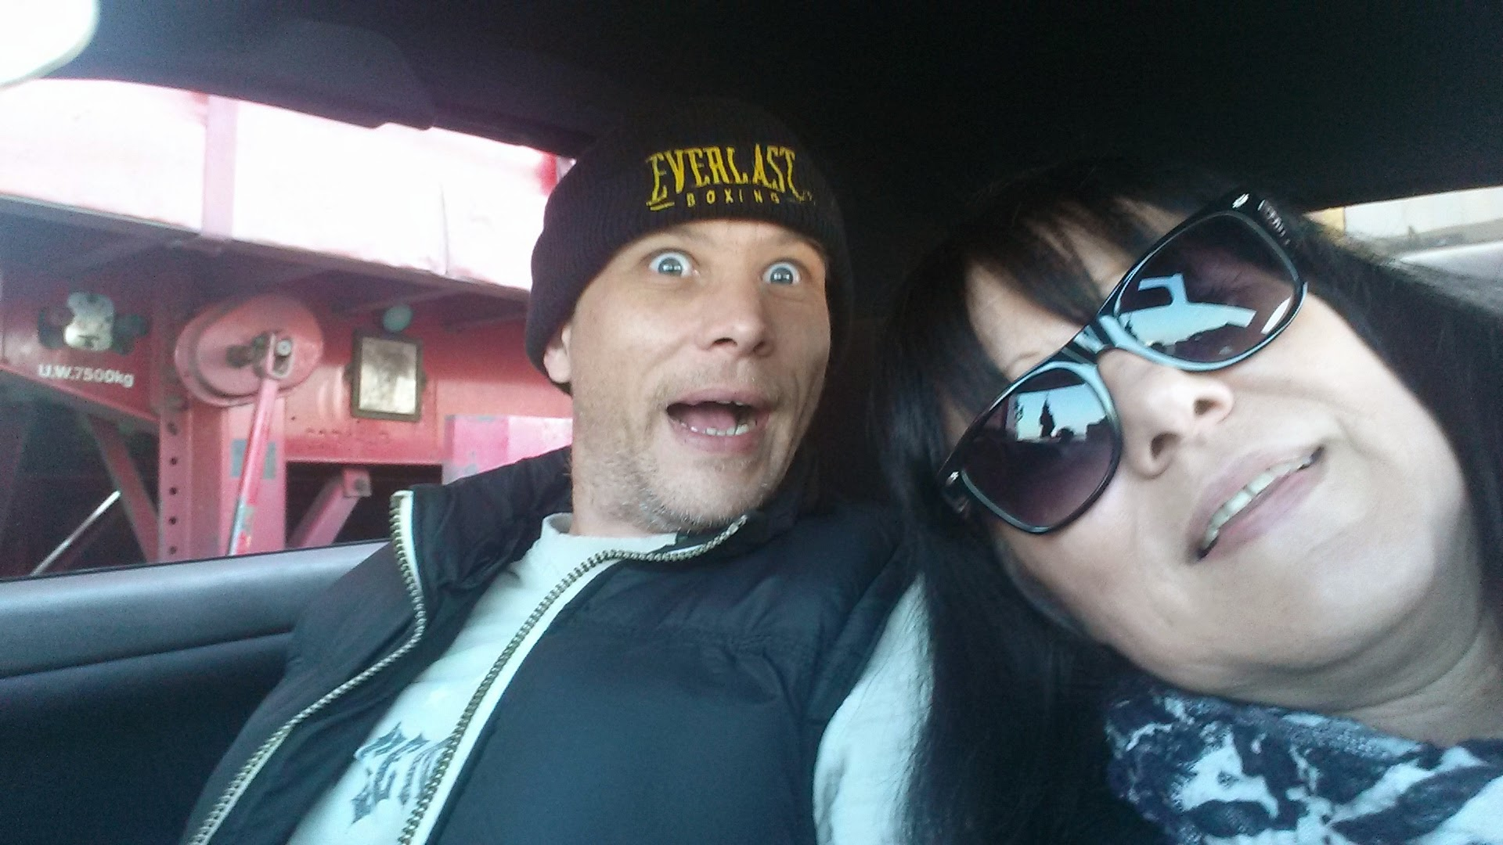
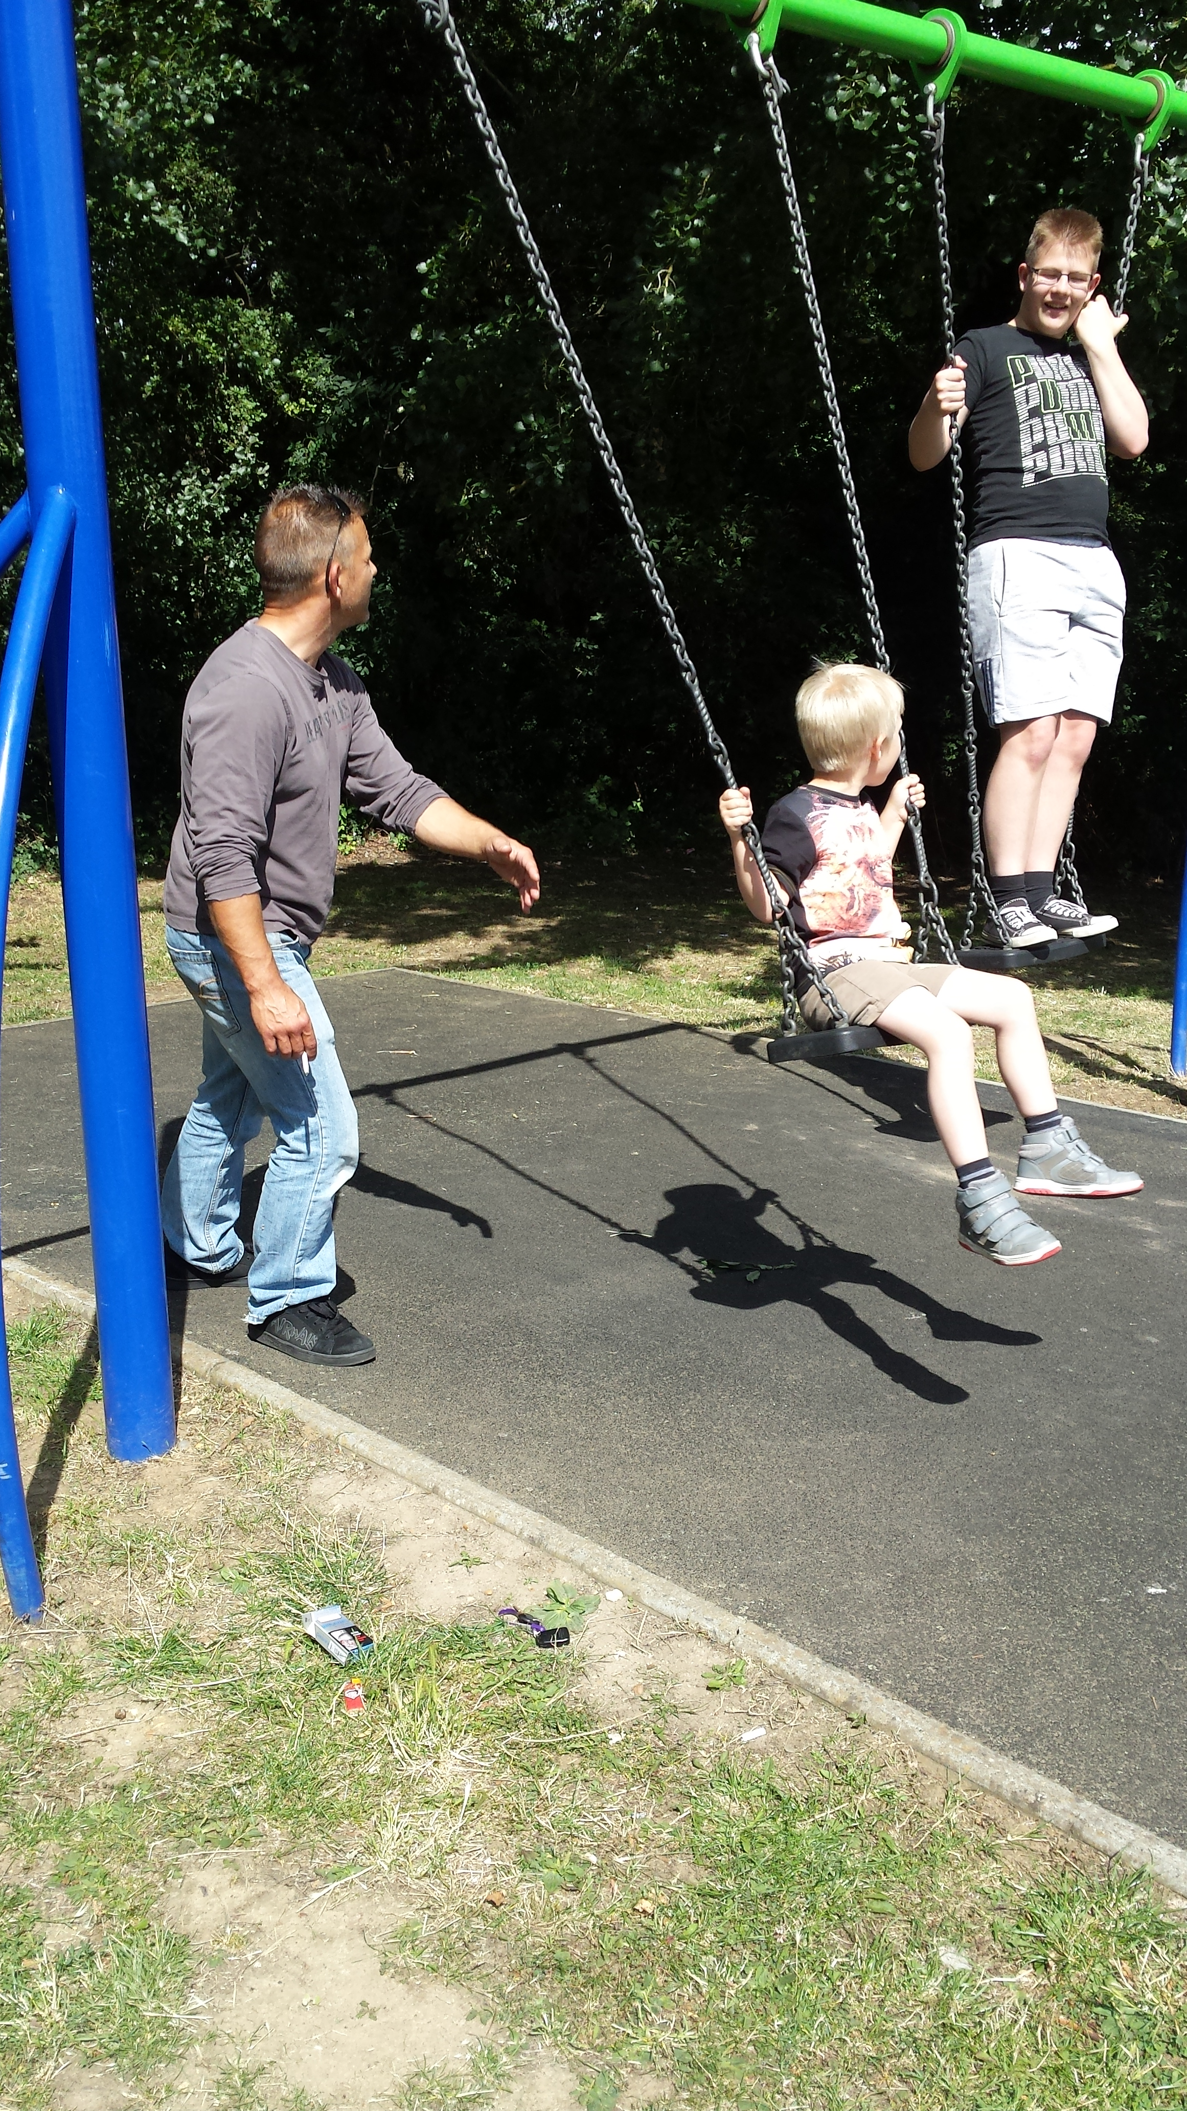
Case Study: Sean Clark’s story
We first met Sean in 2014 – for his first claim
2016 – Sean’s second claim
A 47 year old geographical engineer
Has 2 sons and dating Carolyn – his partner

Slide 6
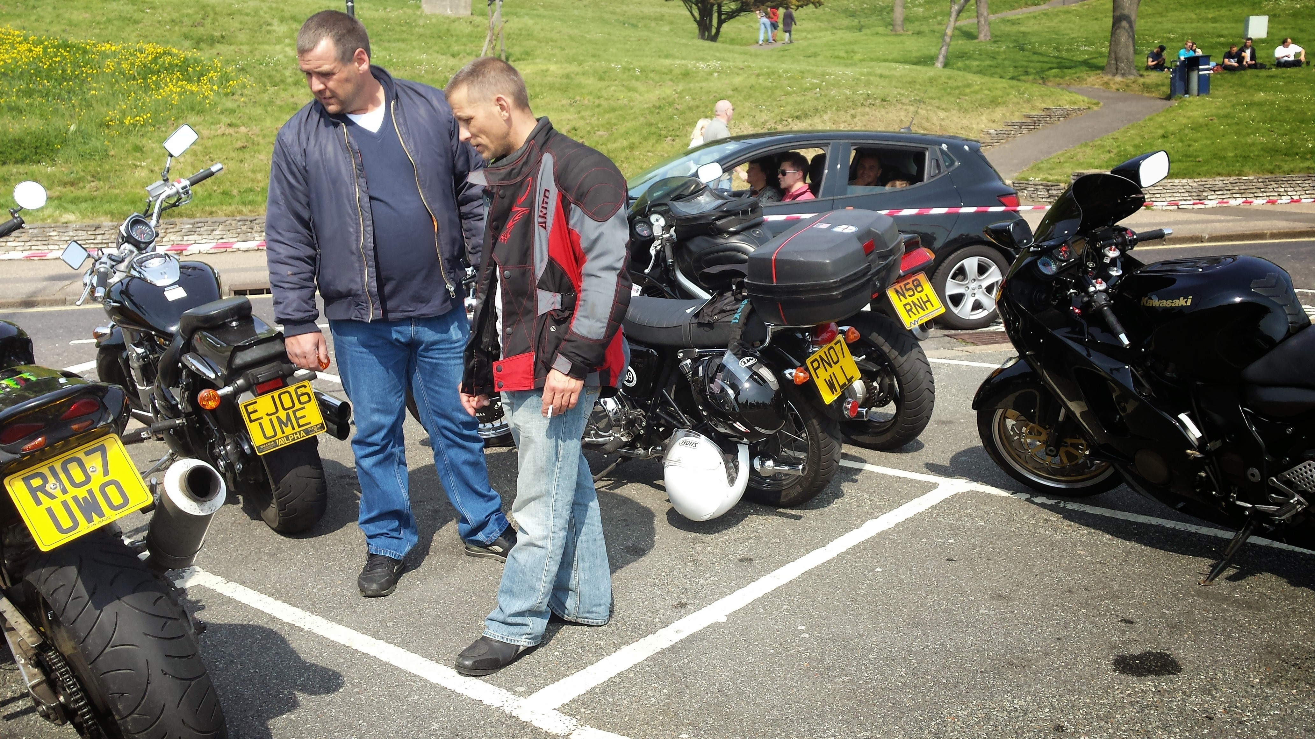
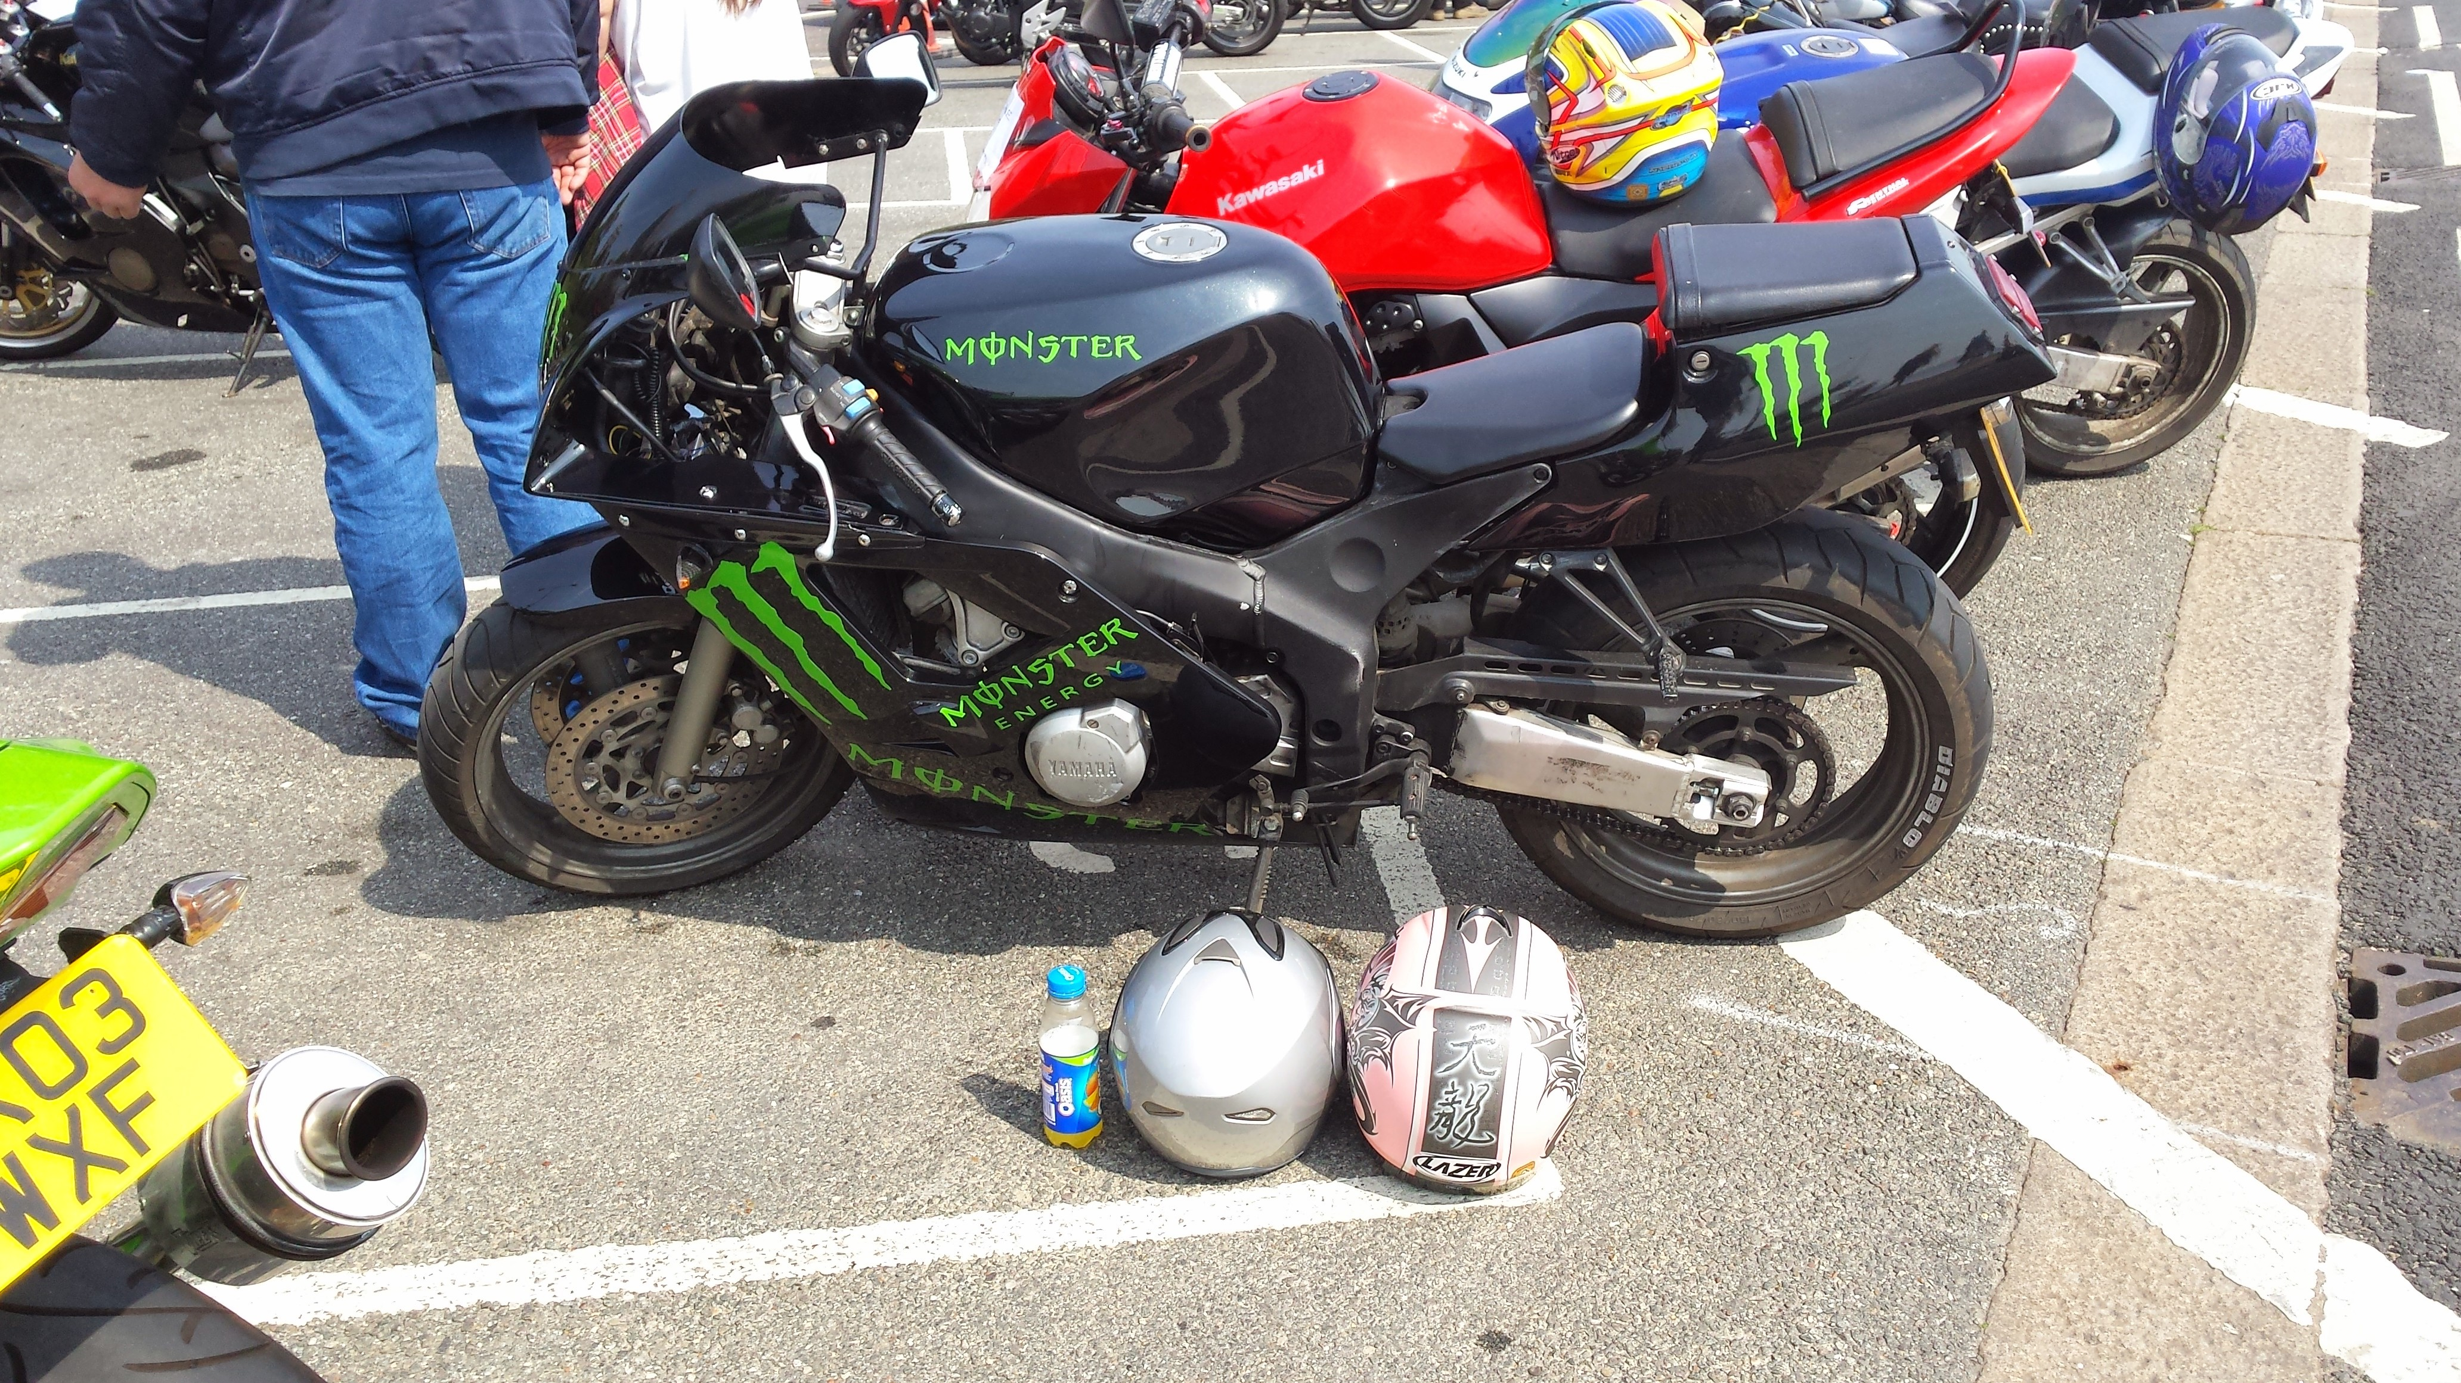
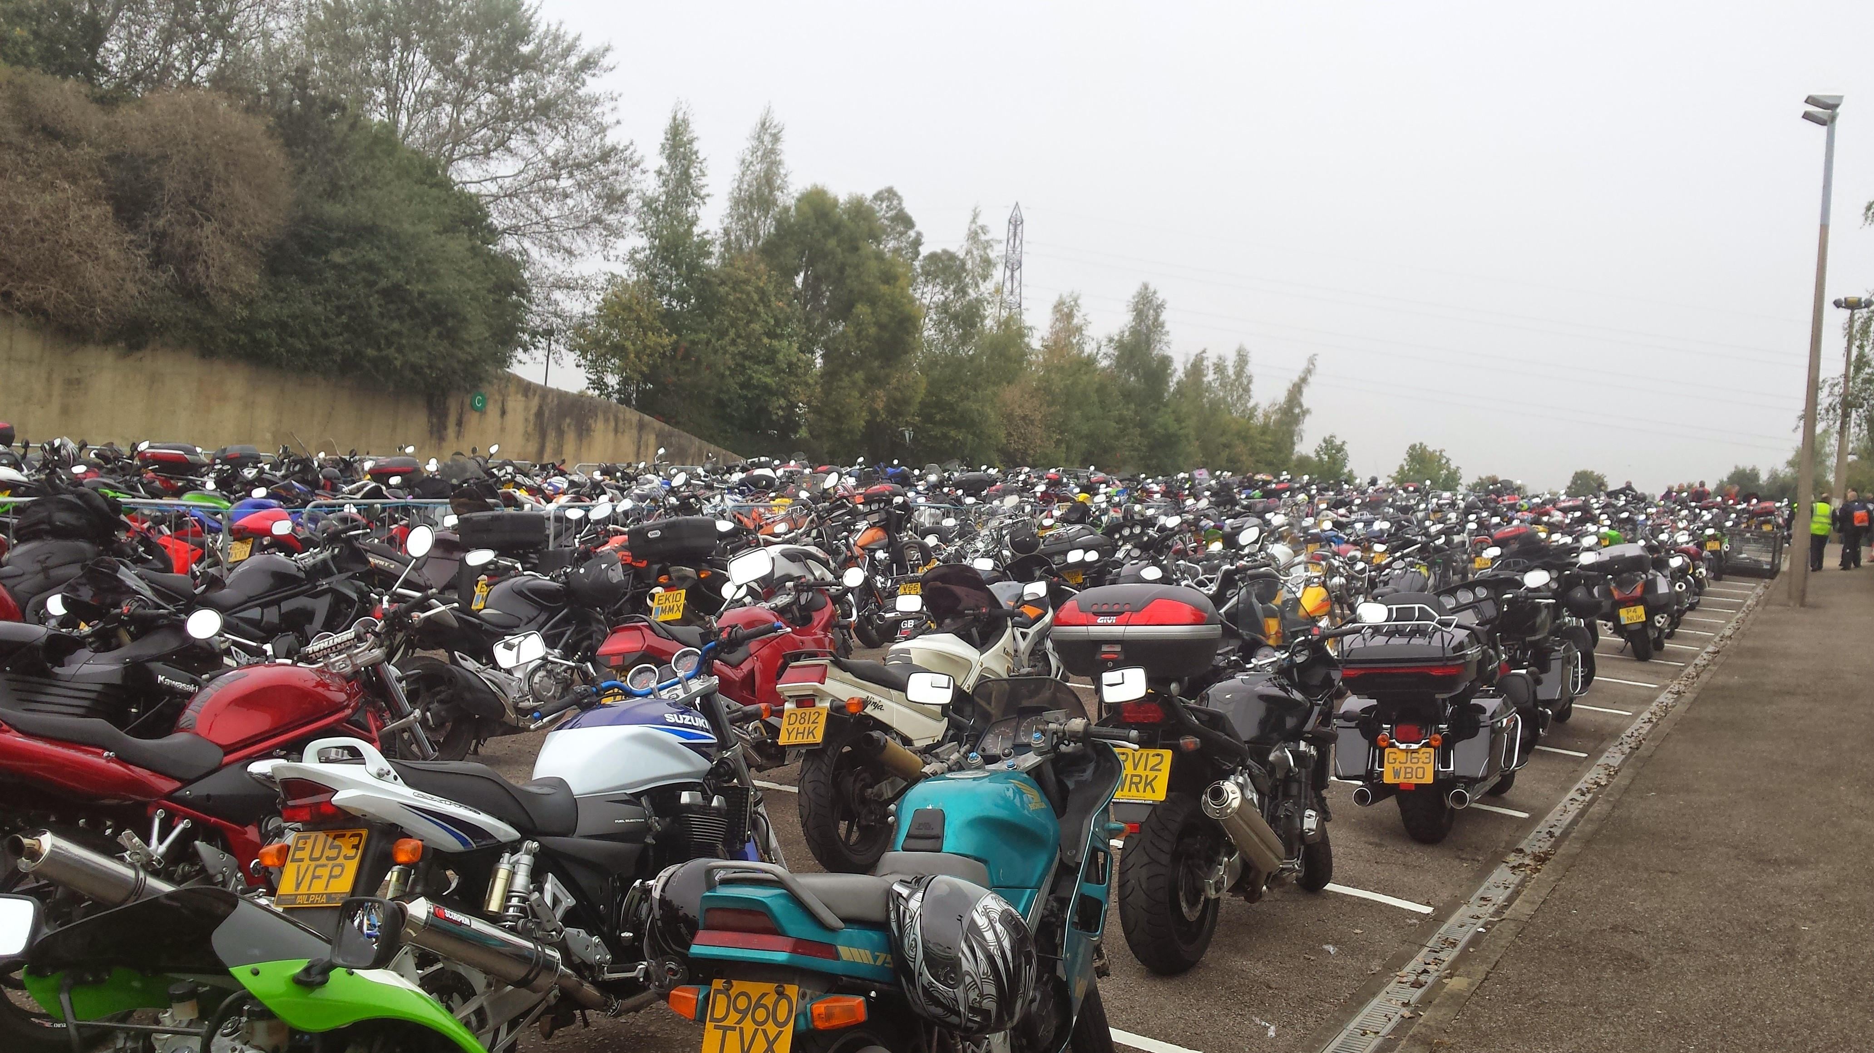
Case Study: Sean Clark’s story
Extremely passionate about motorcycles

Slide 7
Case Study: Sean Clark’s story – The case
27th May 2016
Riding his motorcycle
Defendant emerged from a side road without making adequate observations
Sean was knocked off his motorcycle

Slide 8
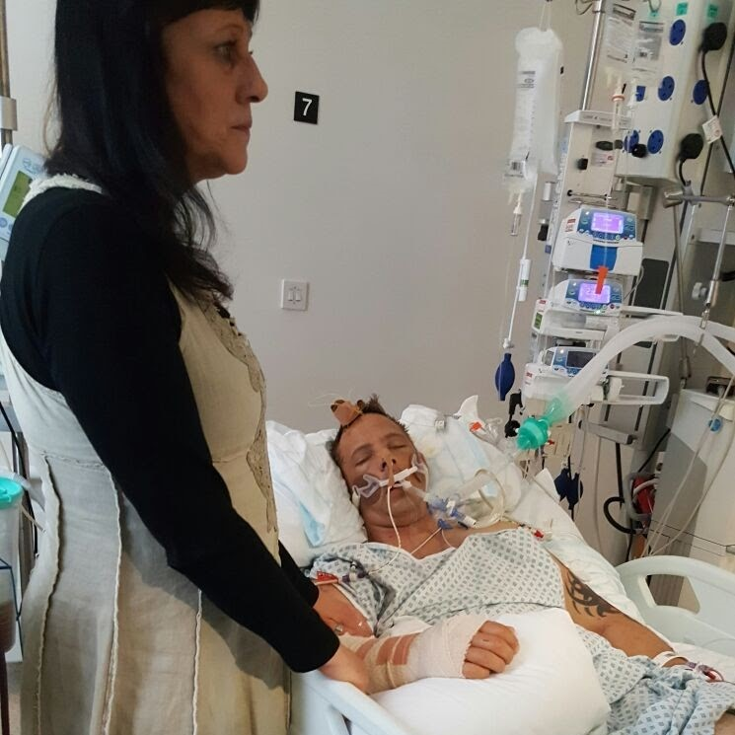
Case Study: Sean Clark’s story – The case
Intubated at the scene
Taken to the Royal London Hospital

Slide 9
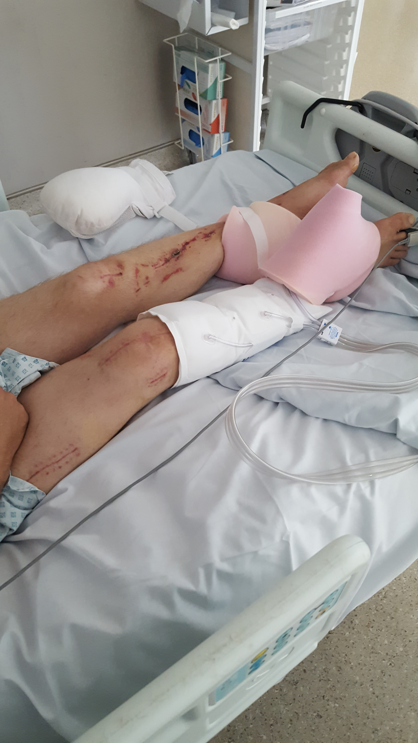
Case Study: Sean Clark’s story – The case
Sean’s injuries included:
A diffuse axonal injury
Multiple contusions to the brain
Traumatic subdural and subarachnoid haemorrhages
T2/3 cord contusion and vertebral fractures
Right femur and patella fractures
Left lower limb fractures
Right ulnar and radius fractures
Facial and sternum fractures

Slide 10
Case Study: Sean Clark’s story – The case
Liability was disputed
Primary liability in favour of Sean
Small element of contributory negligence
Engaged in the rehab code
Underwent an initial needs assessment with an experienced case manager

Slide 11
Case Study: Sean Clark’s story – After the accident
Sean’s needs were still vast and included:
Profound fatigue
Double vision
Spasm/tremor
Dysarthria
Requires thickeners
Severe mobility issues
Cognitive impairment
Short term memory loss
Dysexecutive problems
Irritability with strangers and loved ones
Verbally abusive
Disinhibition

Slide 12
Case Study: Sean Clark’s story – After the accident
A full package of care and rehabilitation was instigated by the case manger
The package included:
Occupational therapy
Speech and Language therapy
Neuropsychology
Neurophysiotherapy
Ophthalmic Assistance
Orthopaedic specialists
Support workers trained in brain injury rehab
Care workers
Psychological support for Sean’s partner

Slide 13
Case Study: Sean Clark’s story – Making progress
Sean has made remarkable progress

Slide 14
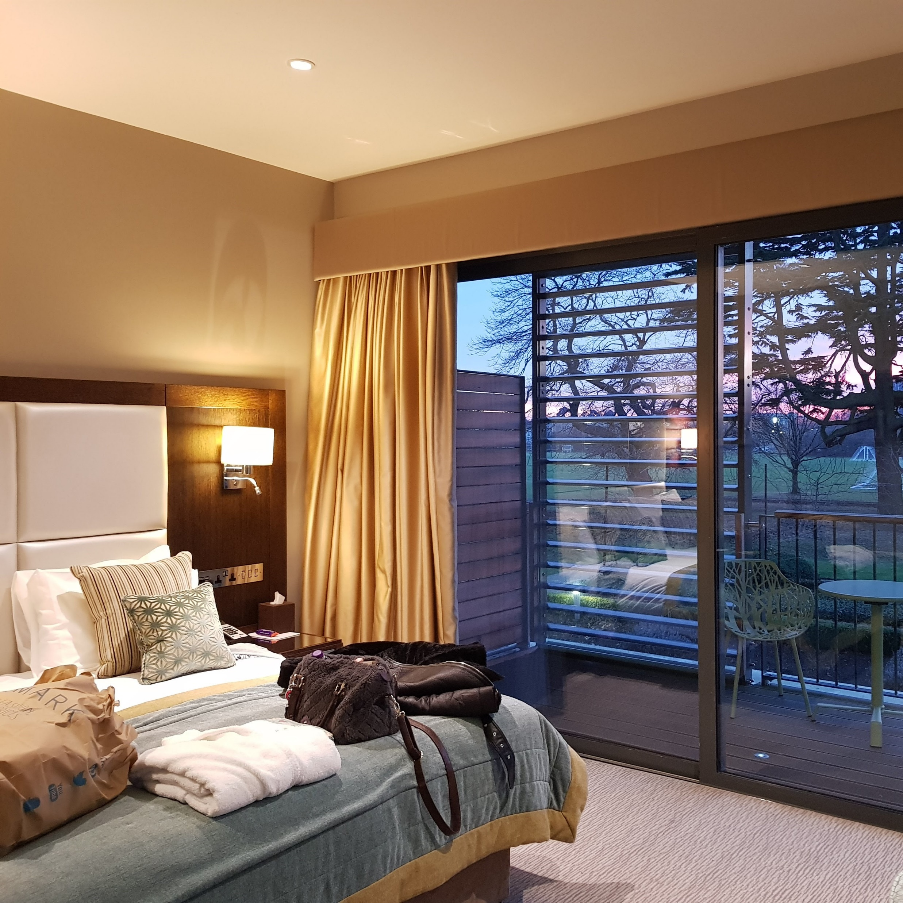
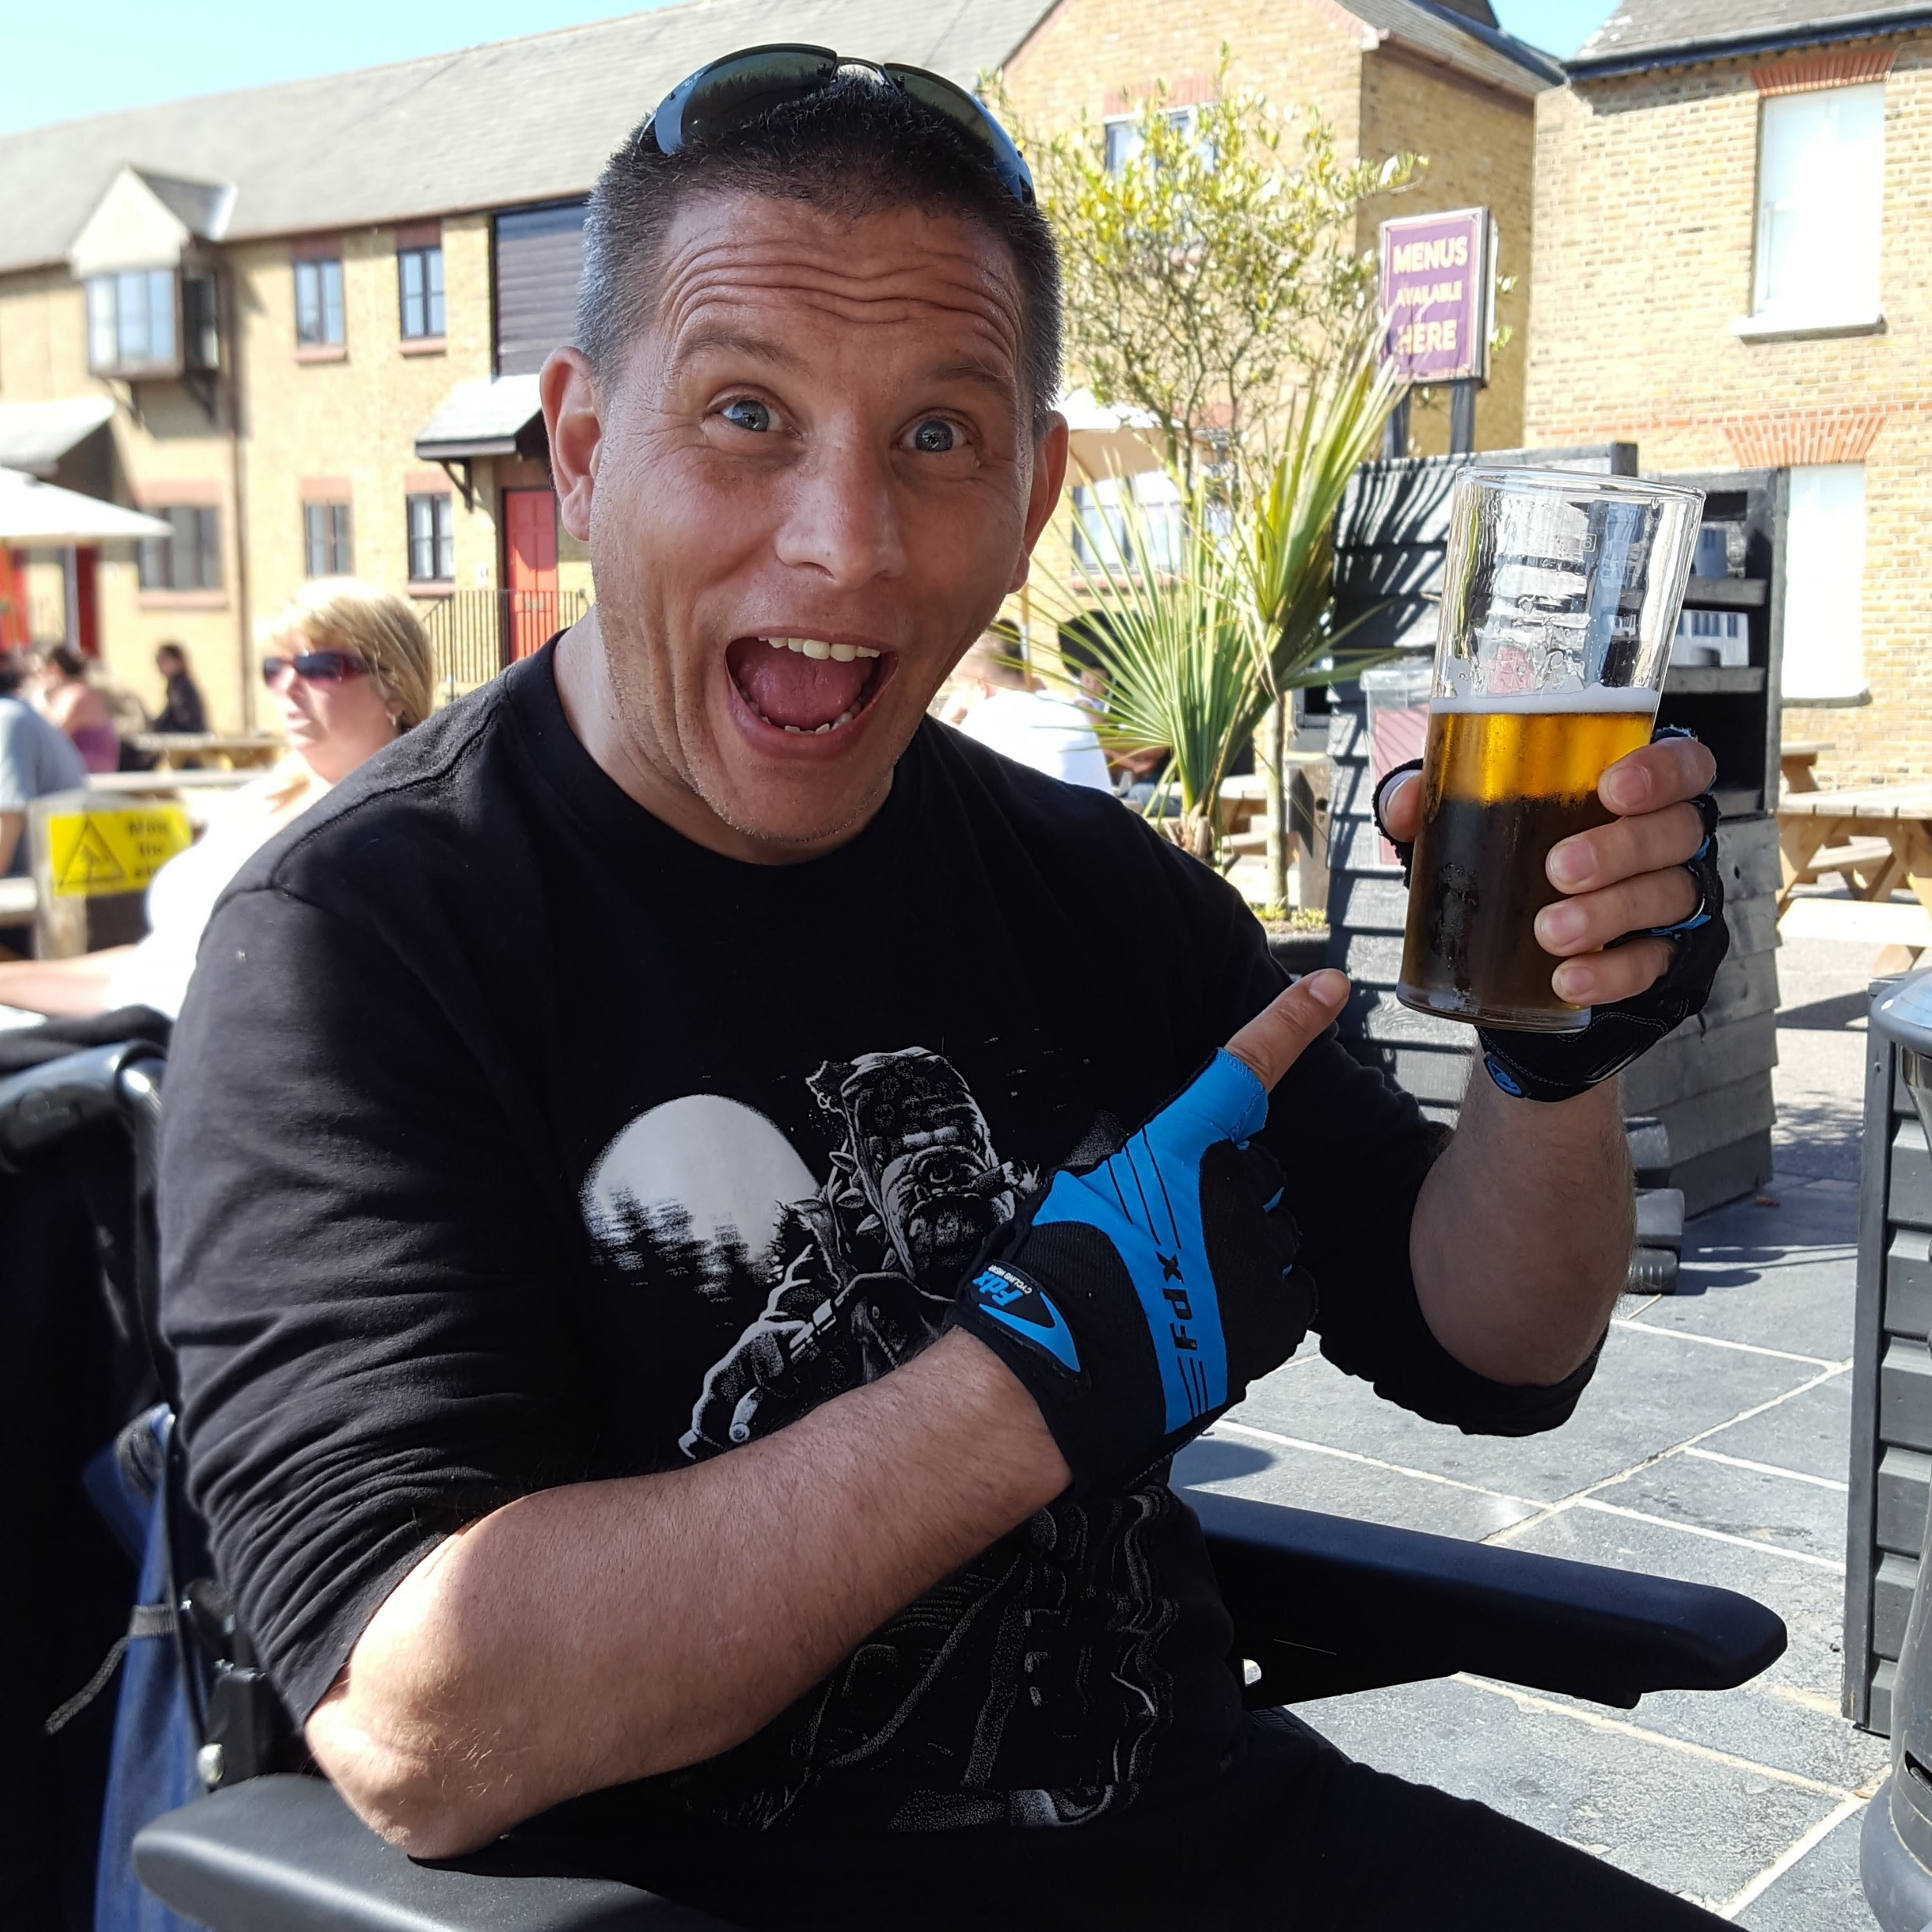
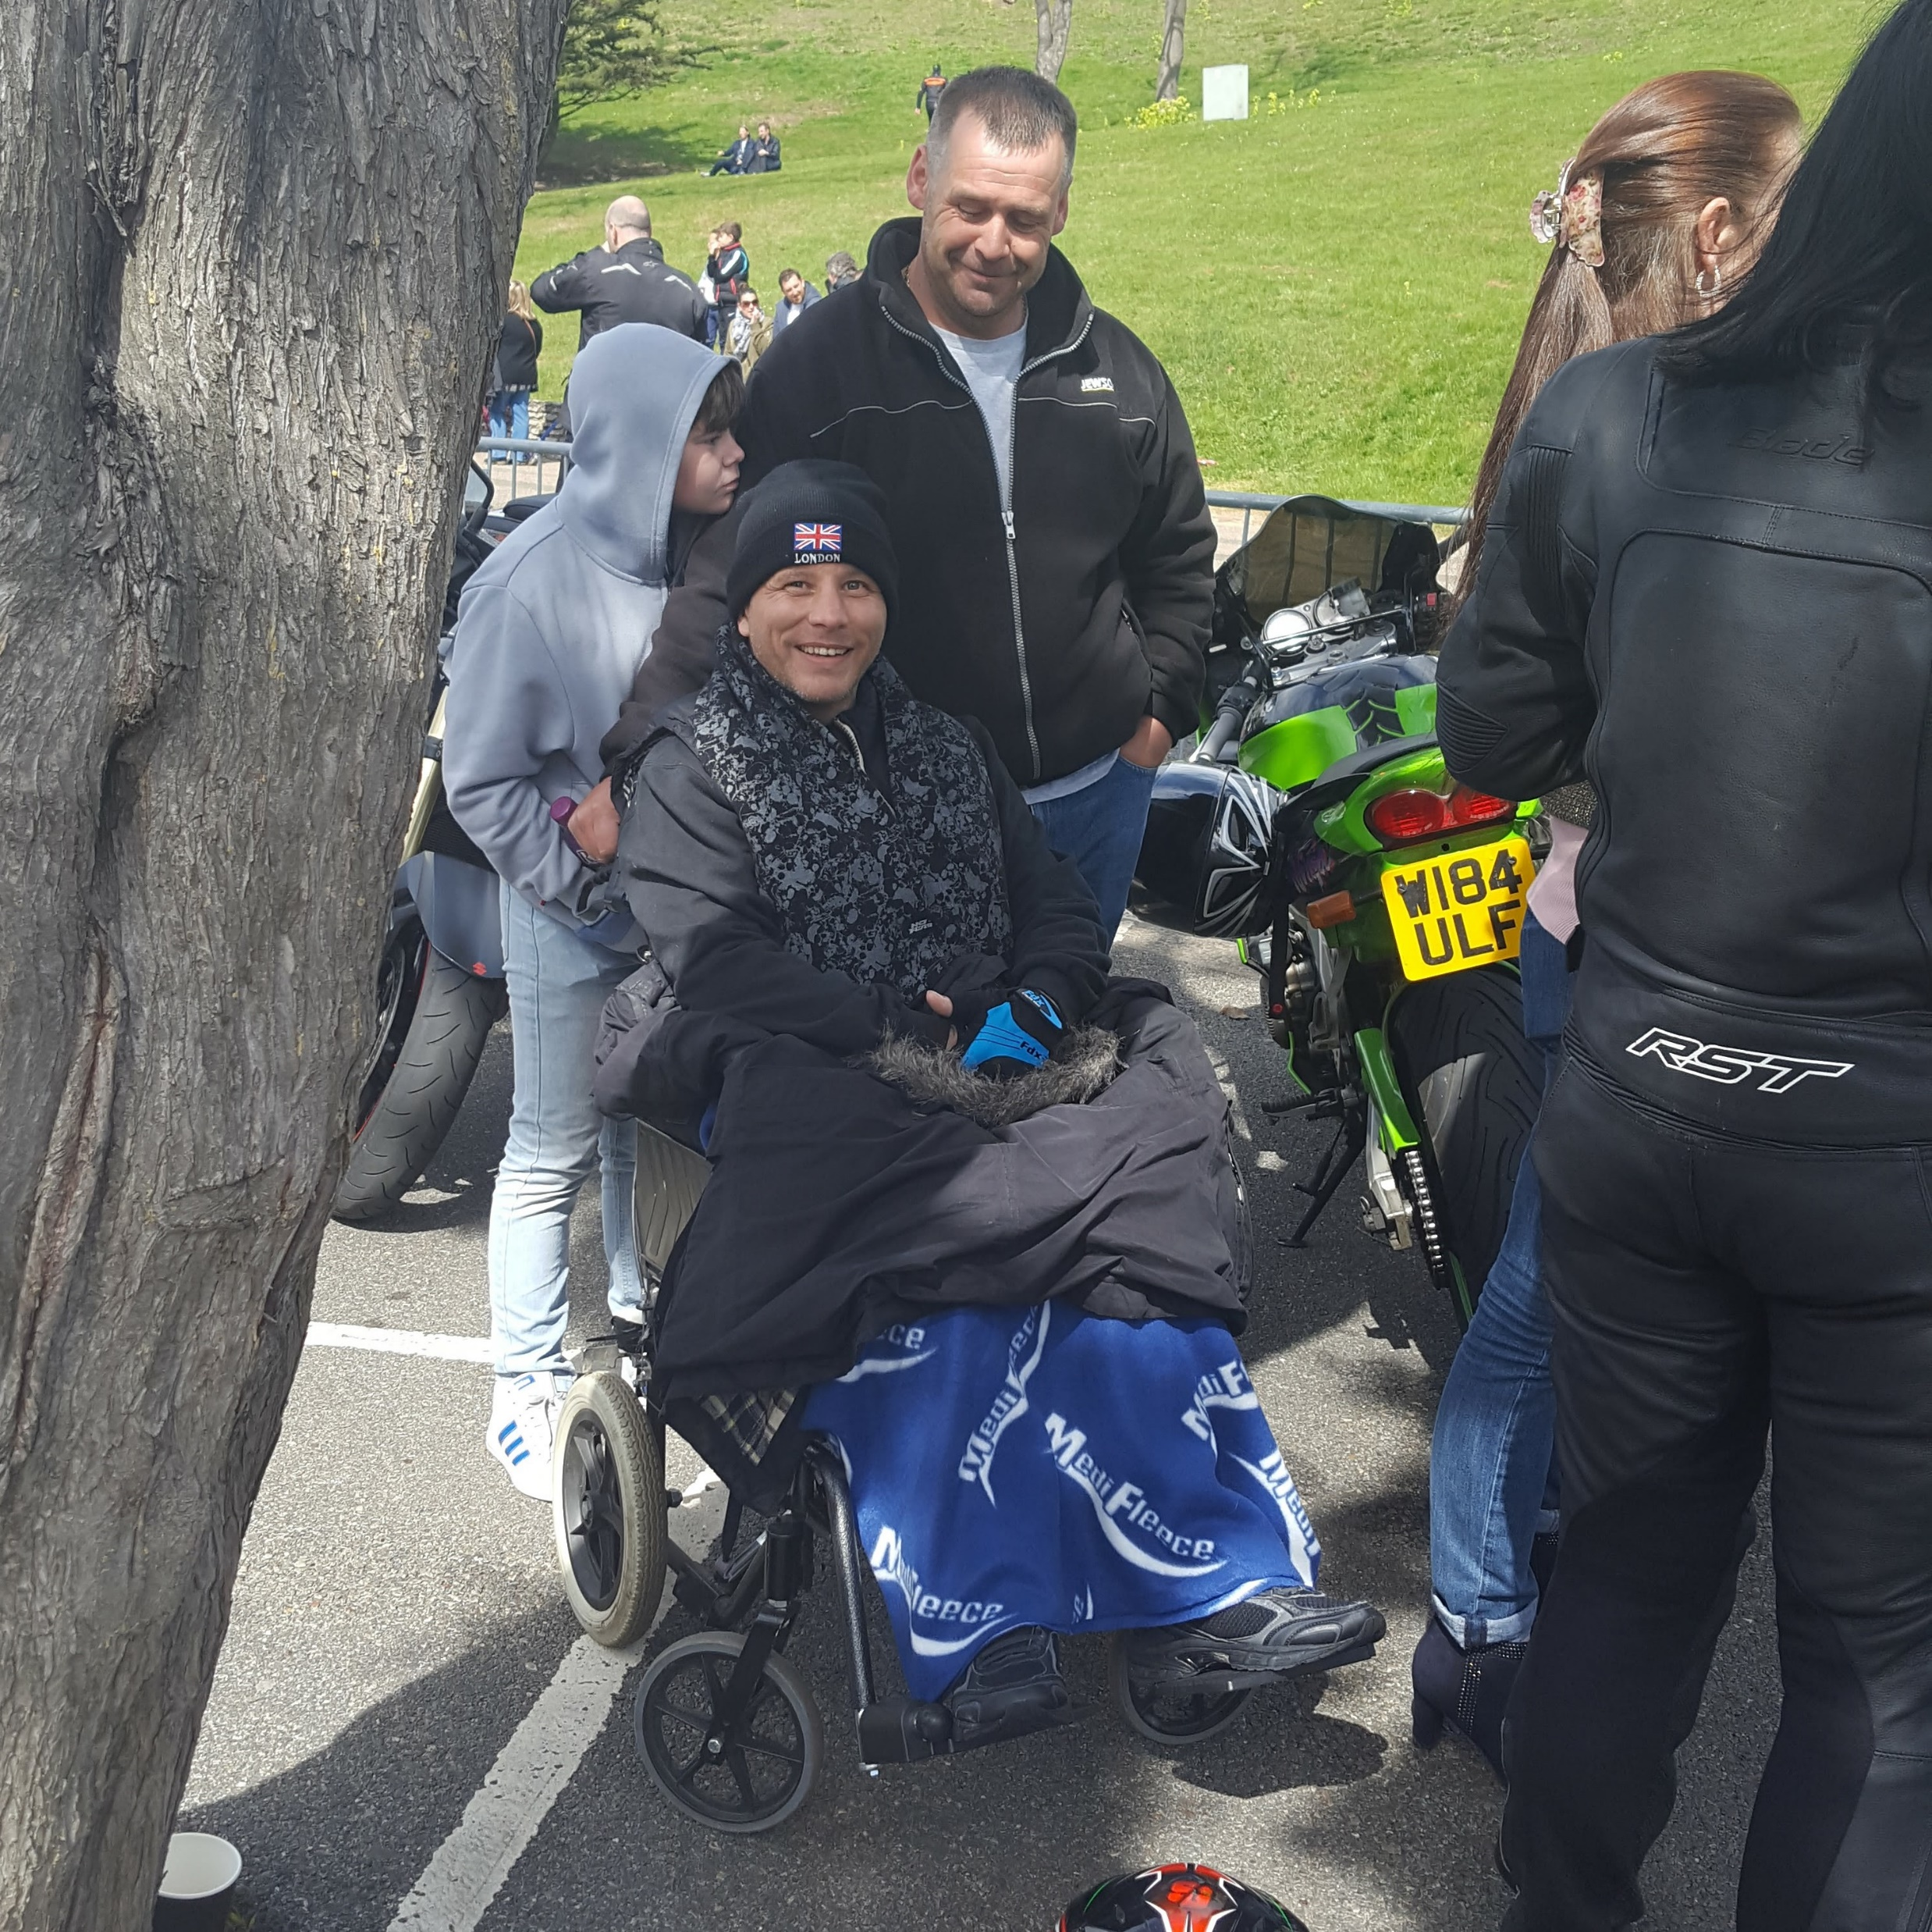
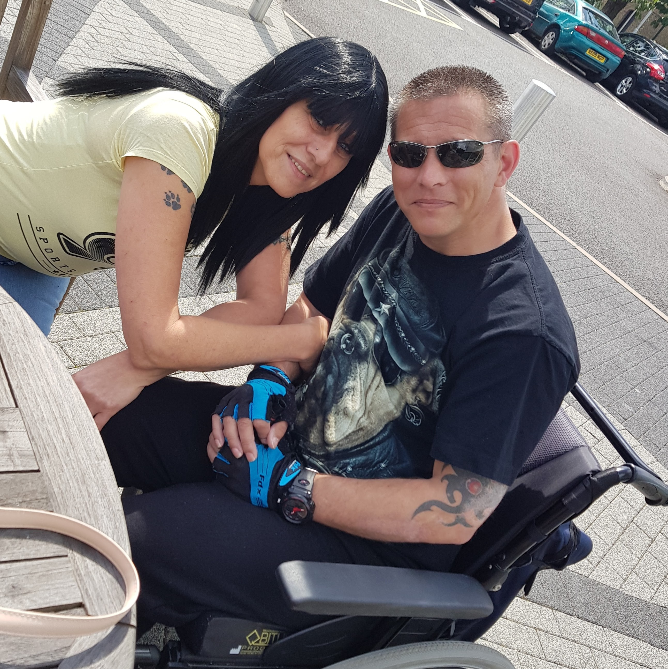
Case Study: Sean Clark’s story – Making progress
Sean’s care was tweaked in order to ensure he had enjoyment in his life as well as his rehabilitation regime

Slide 15
Case Study: Sean Clark’s story – Making progress
One of Sean's main aims had always been to marry Carolyn and to be able to say his vows

Slide 16
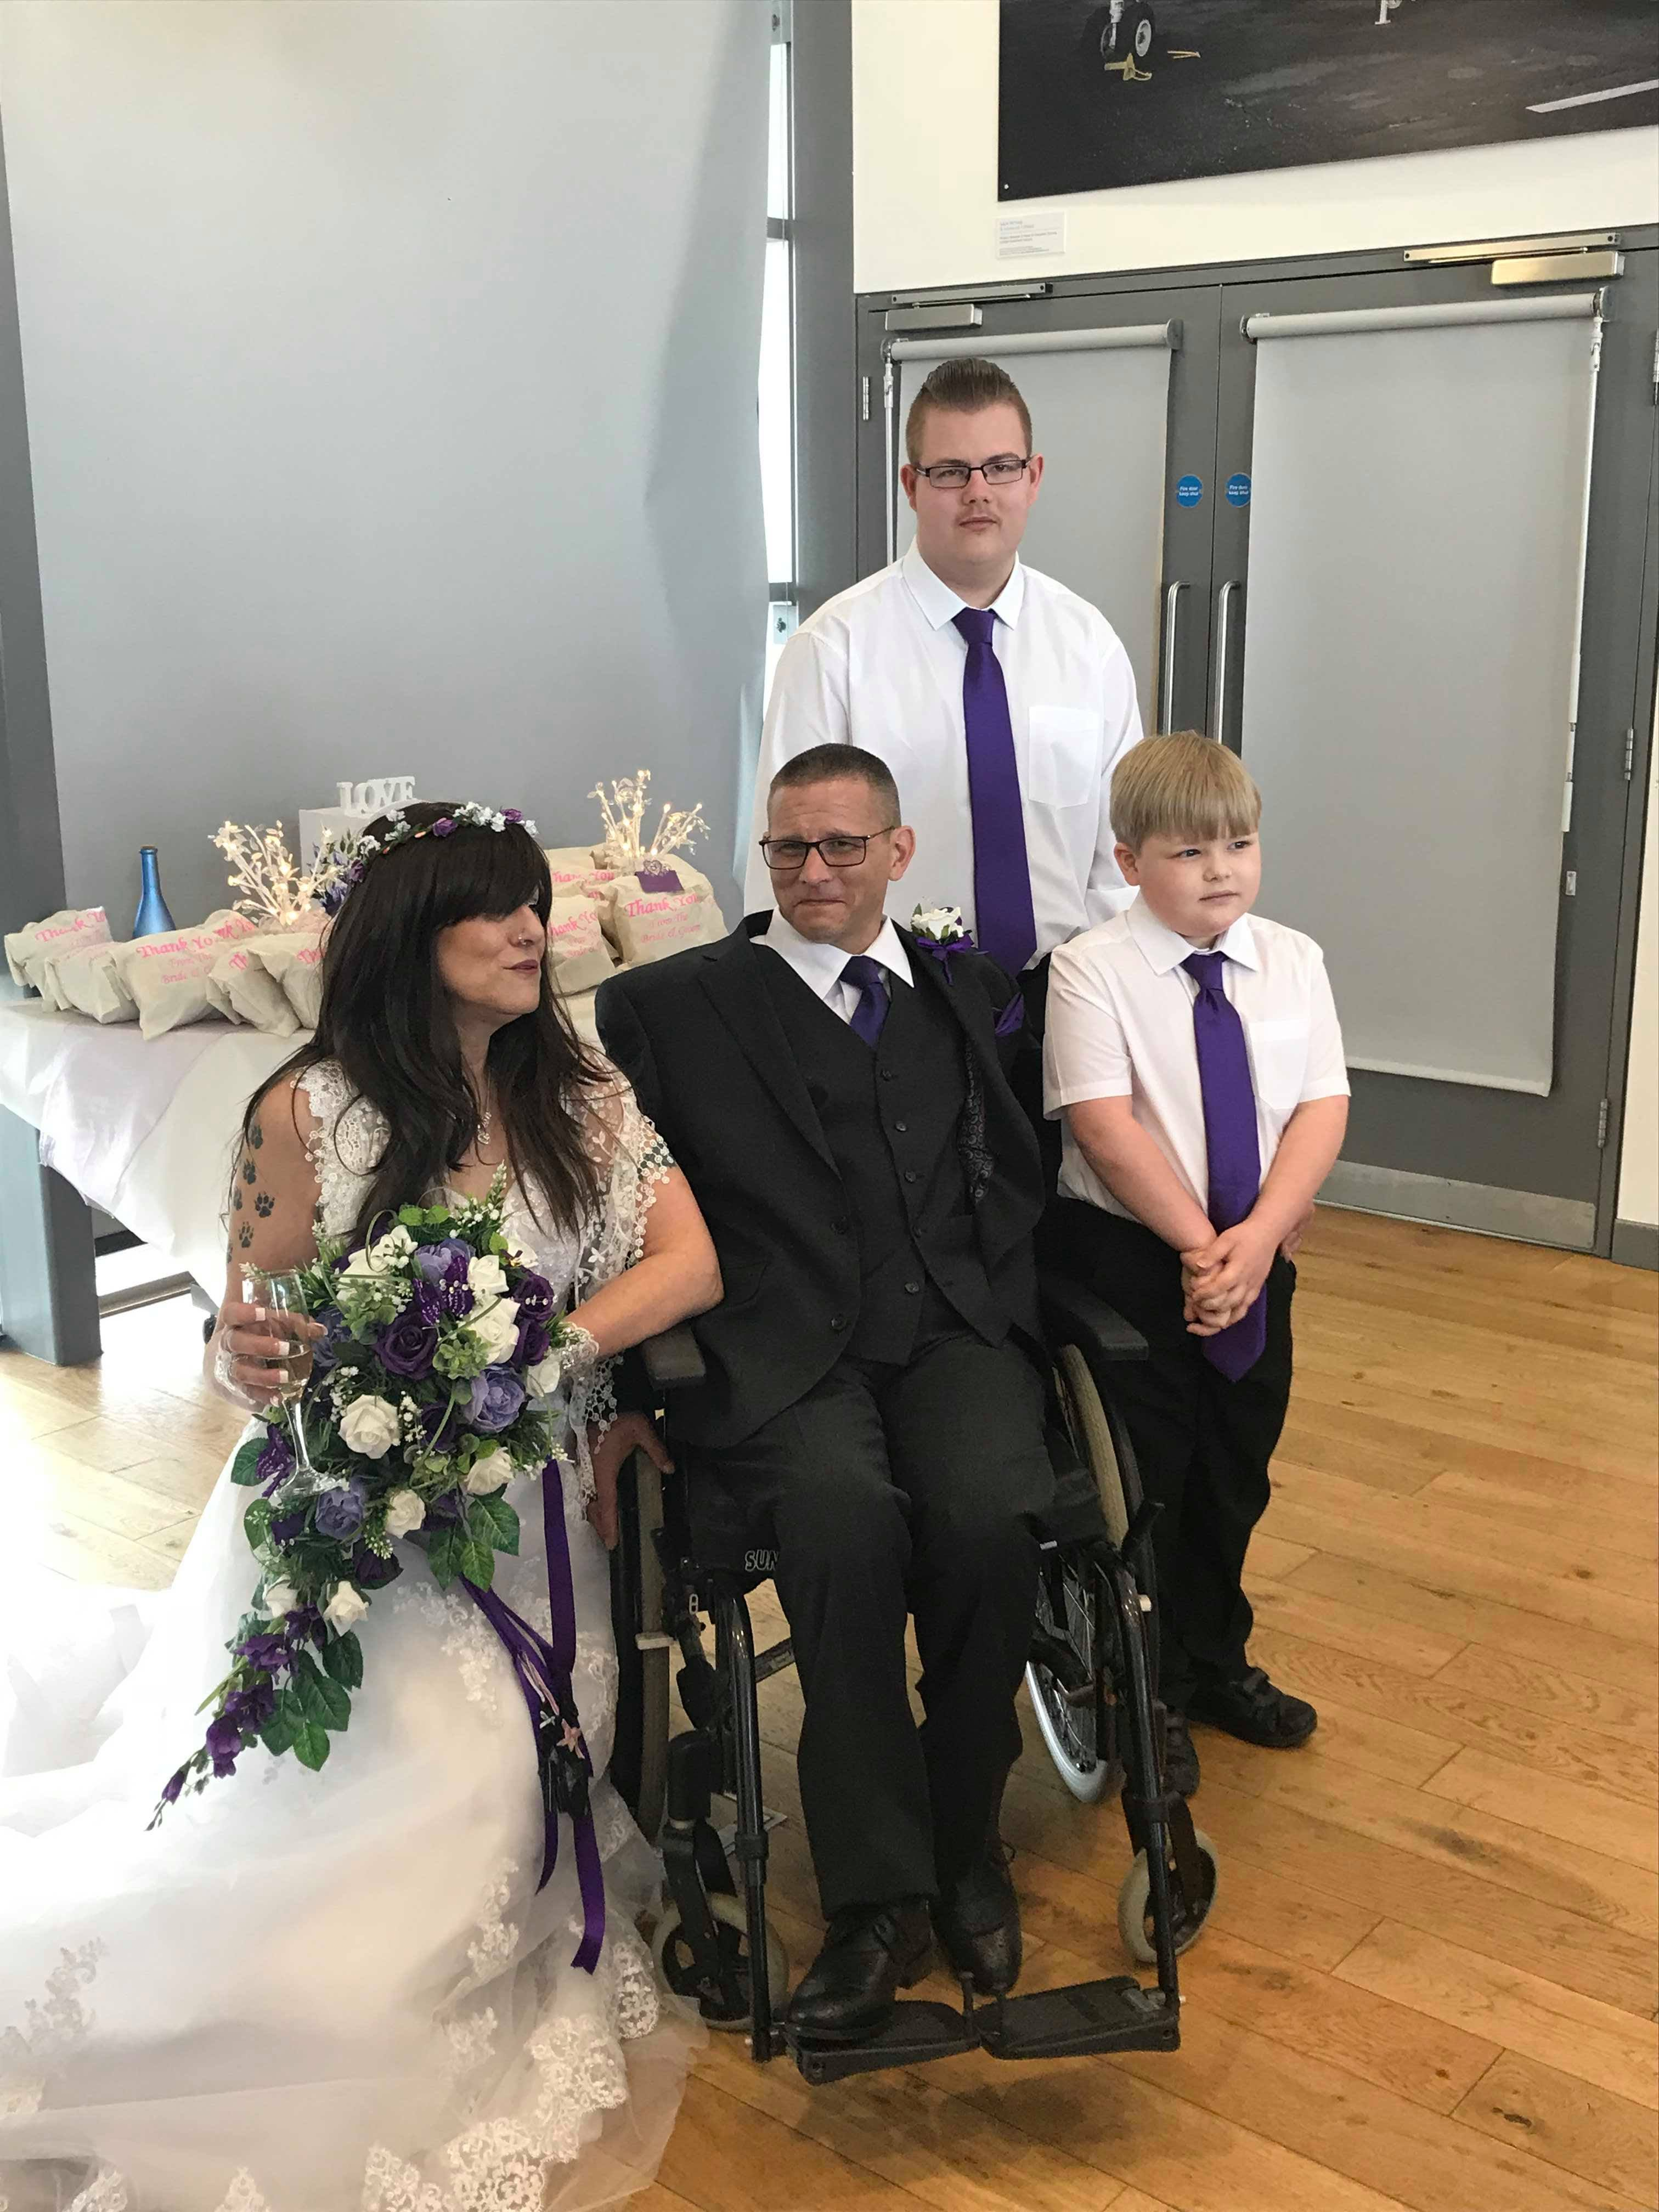
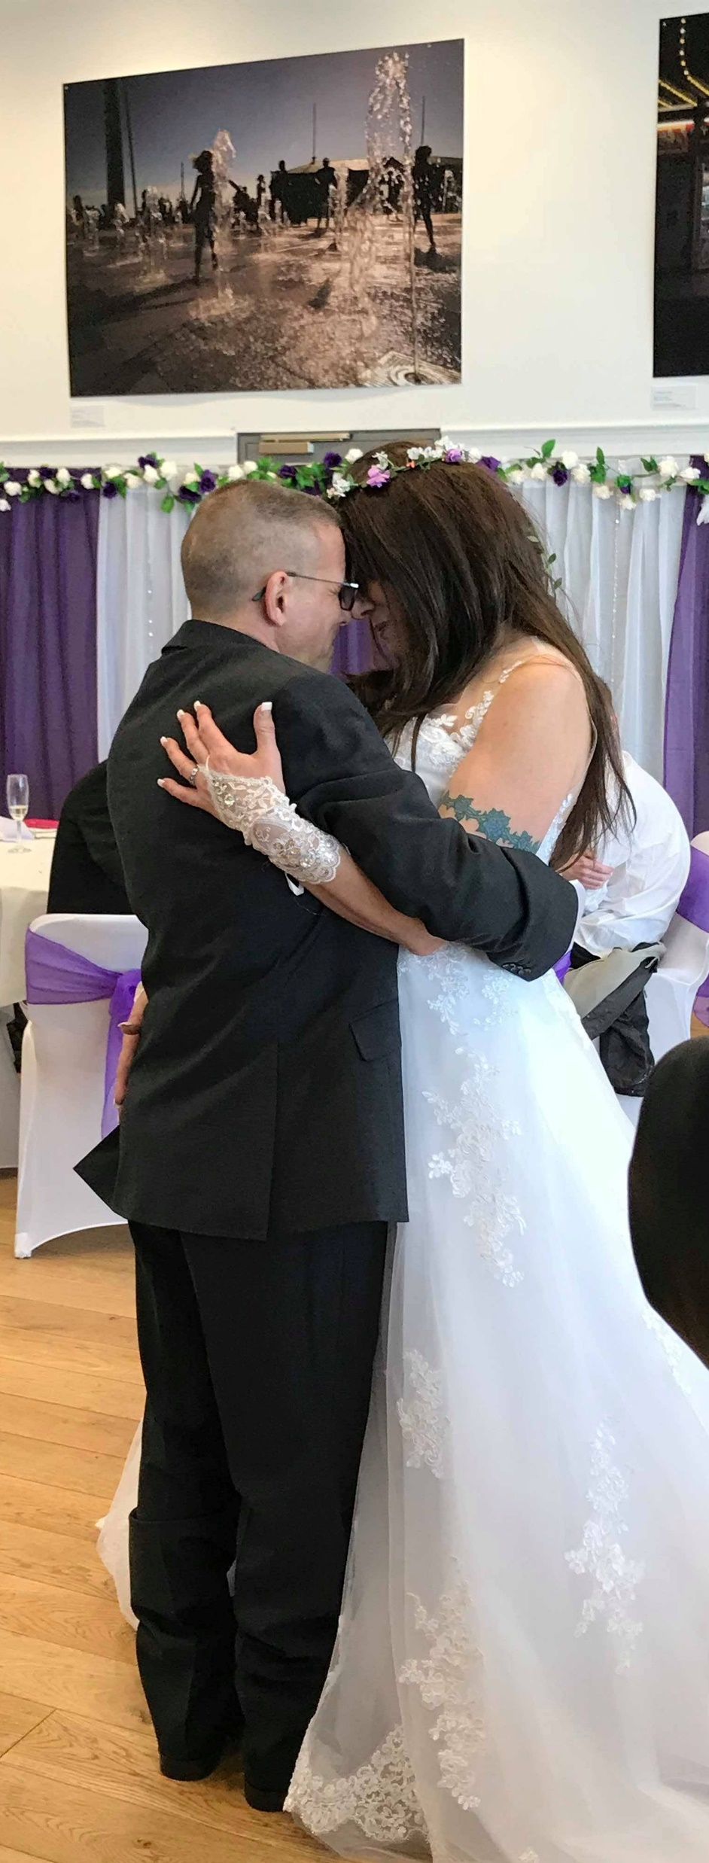
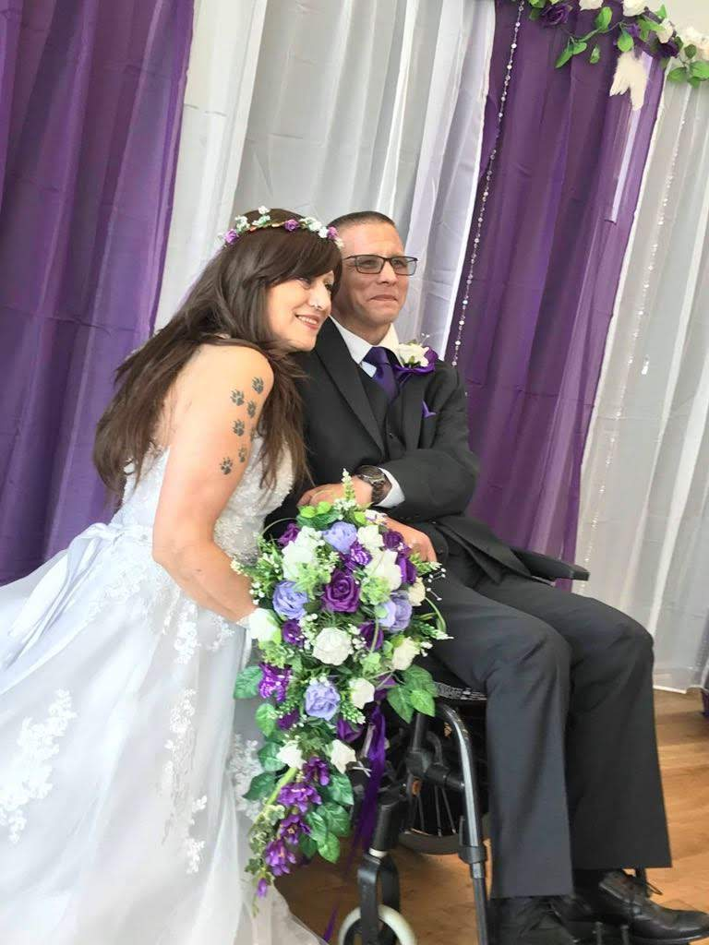
Case Study: Sean Clark’s story – Making progress
Sean achieved his ambition and is now happily married to Carolyn

Slide 17
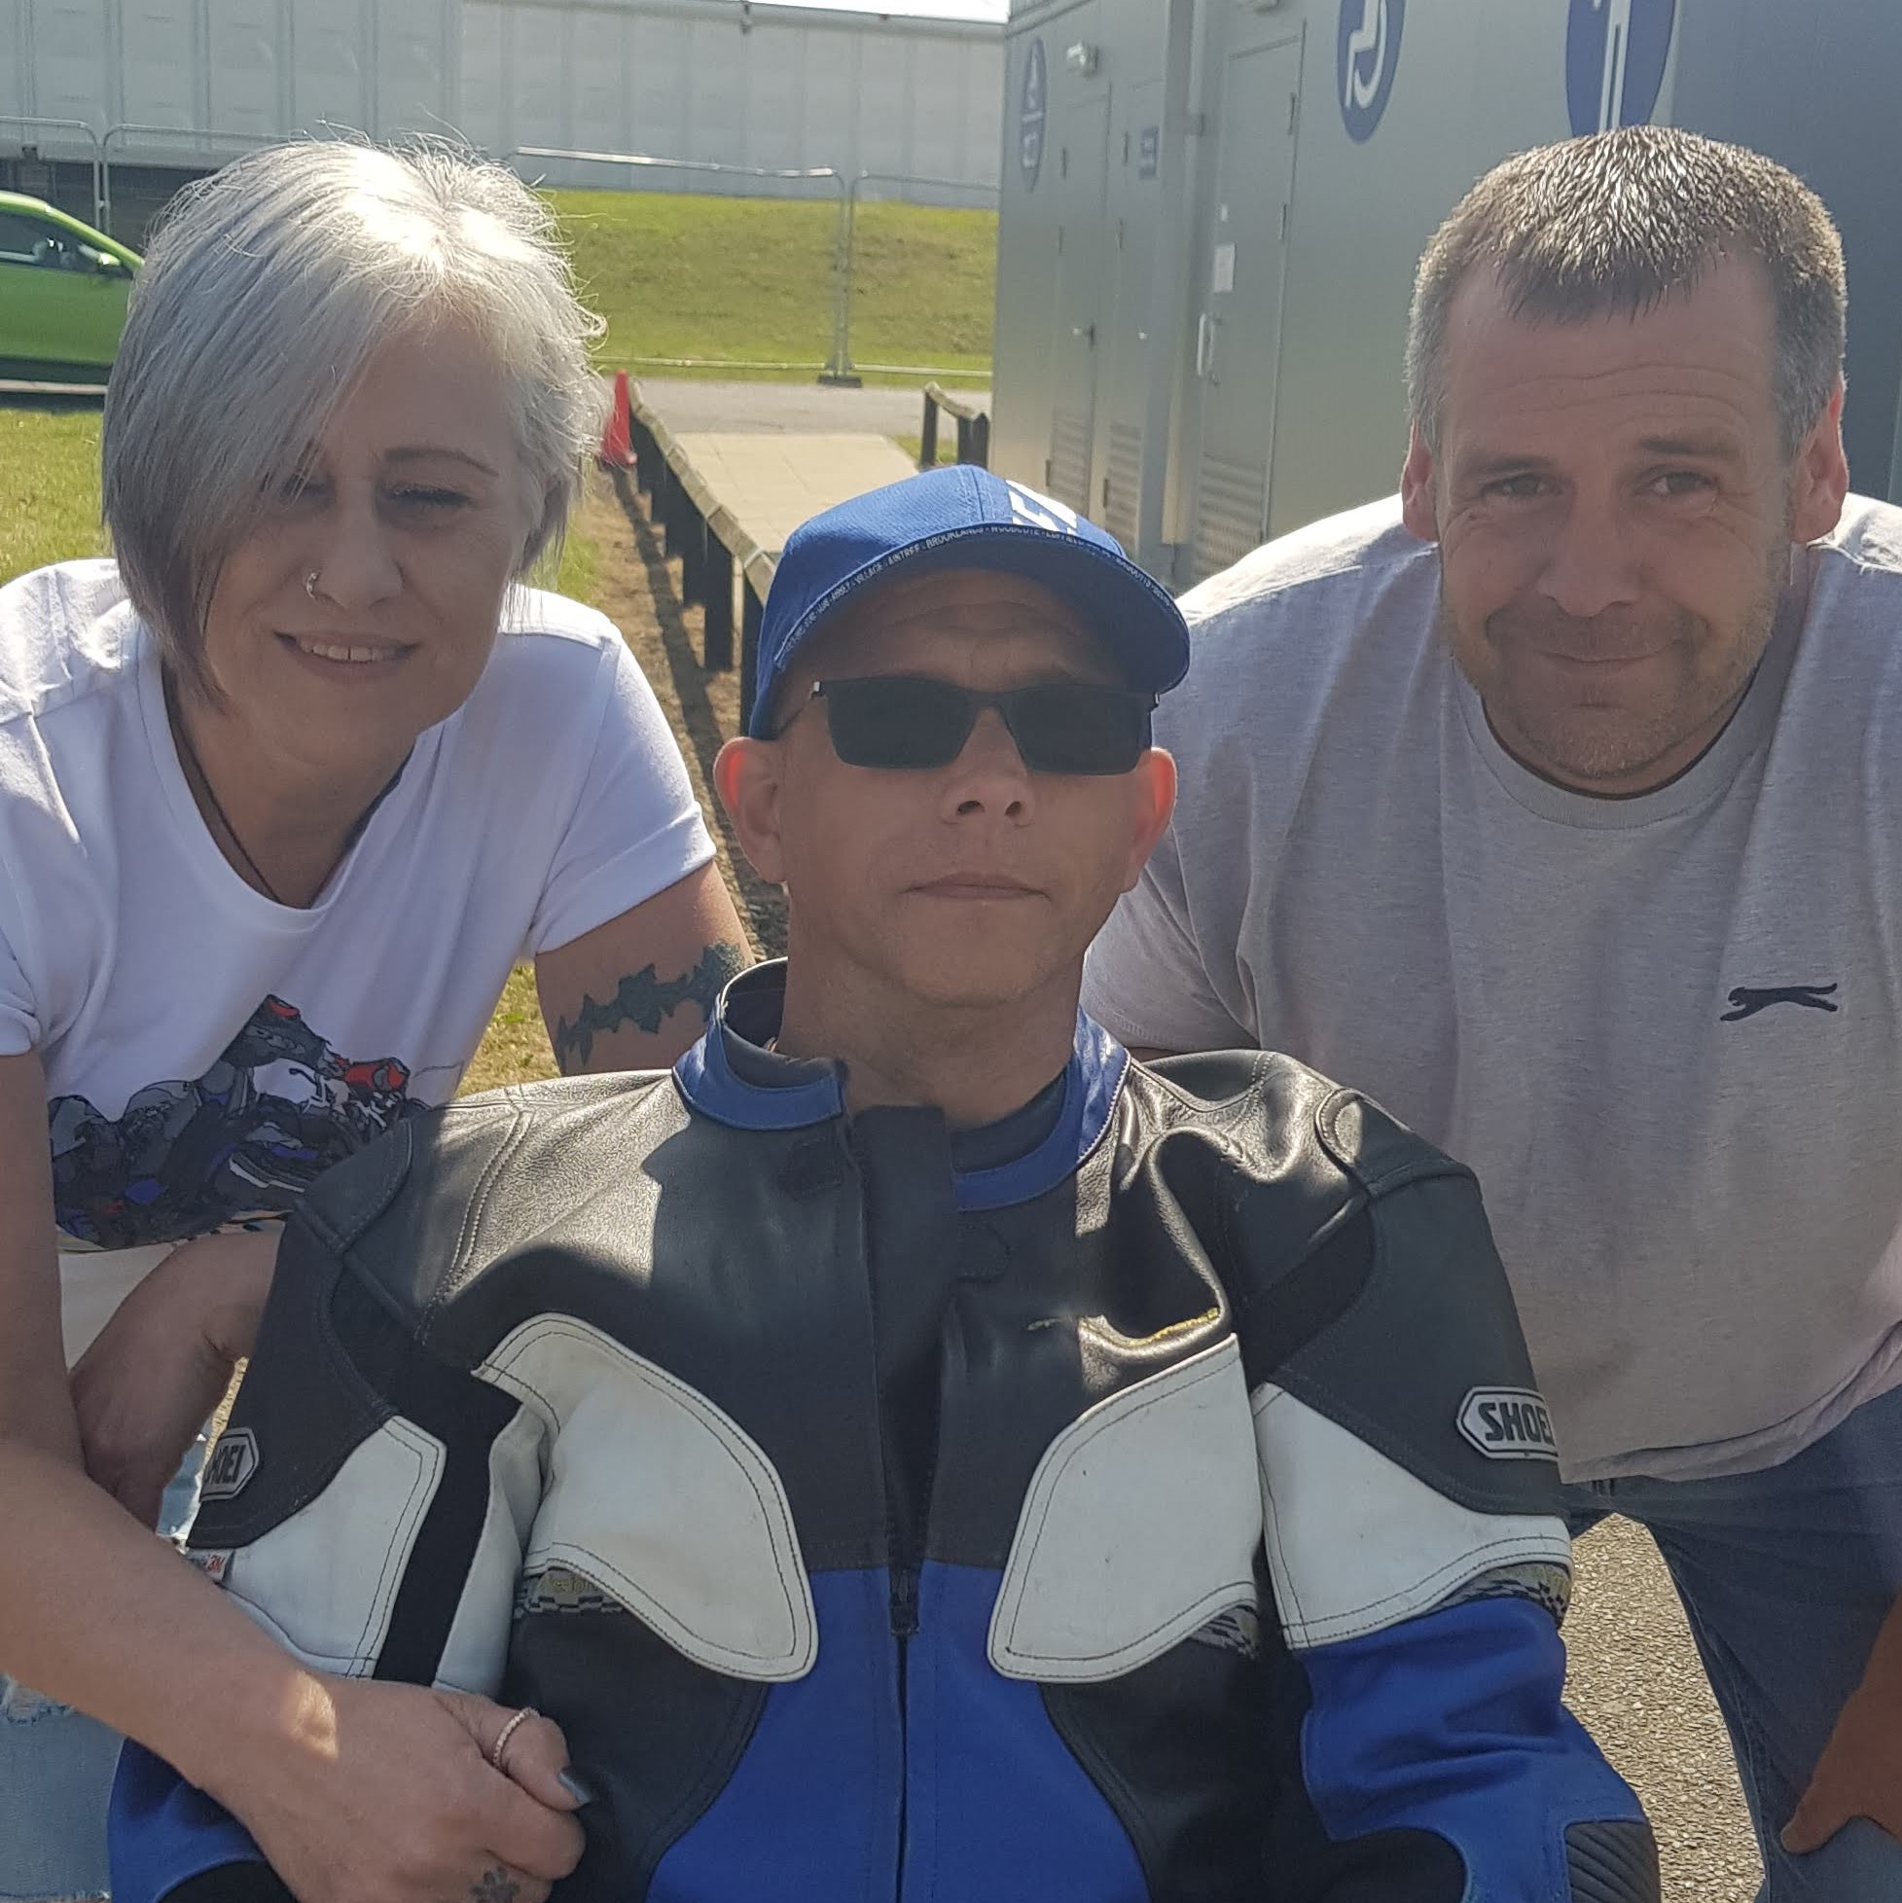
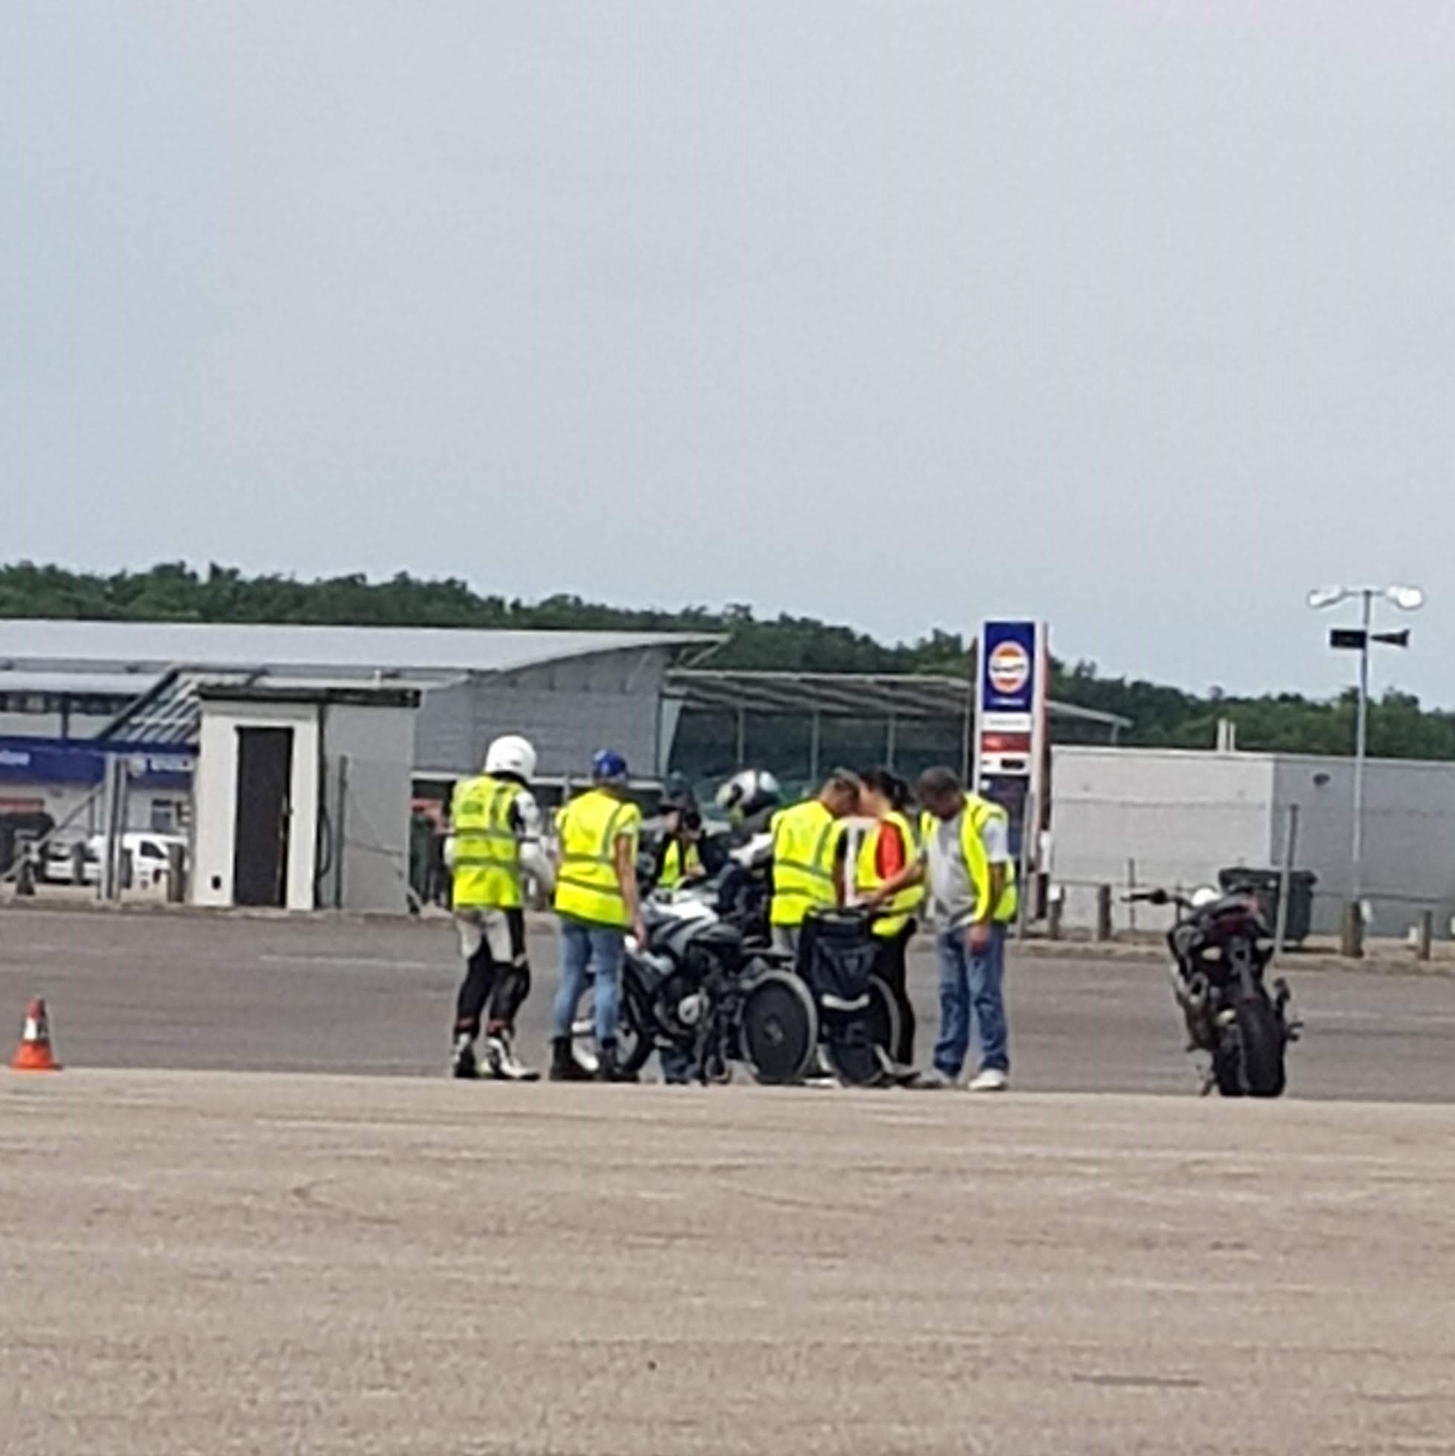
Case Study: Sean Clark’s story – Making progress
Sean has also ridden a motorcycle again thanks to The Bike Experience

Slide 18
Proud to support BIRT
Brain injury rehabilitation is vital for our clients
Supported BIRT since 2011
We share BIRT’s values
Commitment to providing brain injury rehabilitation
Supporting the families as well as the brain injury victims

Slide 19
Contact Us
If you have any questions we’d love to hear from you.
Telephone: 0800 1979 345
Email:
MaryLomas@thorneycrofts.co.uk
You can learn more about our firm and our services by visiting our website:
www.thorneycroftsolicitors.co.uk

